Slide 1


FINANCIAL RISK MANAGEMENT AND ENGINEERING
Session 7: Liquidity Risk & Operational Risk
Notes:
Session 7 of 12. Today we cover two risk categories that are hard to quantify but extremely costly when ignored. Liquidity risk brought down Northern Rock and amplified the GFC; operational risk destroys billions in a single day (Barings, Kerviel, SVB). These are the final topics feeding Assignment 2: students will implement LVaR and an operational-loss simulation before the next session.

Slide 2
Learning Objectives
By the end of this session you will be able to:
1. Distinguish market liquidity risk from funding liquidity risk and explain how they interact
2. Compute the Amihud illiquidity ratio, the Corwin-Schultz bid-ask spread proxy, and Liquidity-adjusted VaR (LVaR)
3. Explain the Basel III liquidity standards LCR and NSFR and their 100% floor
4. Define operational risk using the Basel framework and classify events across the seven Basel loss-event types
5. Model operational losses using a compound Poisson-lognormal frequency-severity model and compute aggregate-loss VaR via Monte Carlo
Notes:
Five objectives align to the two main blocks. Objectives 2 and 5 map directly to Assignment 2 coding tasks. Remind students that Sessions 5 to 8 feed Assignment 2 in full, so today's formulae will appear in their exam notebook.

Slide 3
Block 1: Liquidity Risk
Market liquidity, funding liquidity, and liquidity-adjusted VaR
Liquidity is invisible in calm markets and violently visible in a crisis
The two types reinforce each other through the liquidity spiral
Notes:
The central idea: liquidity is invisible in normal times and violently visible in a crisis. The 2008 GFC was as much a liquidity crisis as a credit one (Brunnermeier 2009).

Slide 4
Market Liquidity vs Funding Liquidity
Market Liquidity Risk
Risk of large price impact when selling an asset
Measured by bid-ask spread and Amihud illiquidity ratio
High in thin markets: small-caps, emerging markets, crisis periods
Worsens sharply during stress - correlations spike
Key metric: LVaR = VaR+0.5Vs times
Funding Liquidity Risk
Risk of being unable to meet cash obligations when due
Arises from maturity mismatch (borrow short, lend long)
Classic bank-run mechanism: Northern Rock (2007), SVB (2023)
Regulatory response:
  LCR at least 100% (30-day stress scenario)
  NSFR at least 100% (longer-term structural funding)
Notes:
Brunnermeier (2009) shows the two types are linked: when market liquidity dries up, institutions cannot liquidate assets to fund obligations, turning a market shock into a funding crisis. The liquidity spiral is the key concept: falling prices, margin calls, forced sales, further price falls.

Slide 5
Worked Example: Market vs Funding Liquidity
A bank holds $100M of thinly-traded corporate bonds, funded by $95M of overnight repo
Market liquidity risk (the asset side)
To raise cash it must SELL the bonds; the bid-ask is 2%, so a quick sale costs about $1M
In stress the spread widens to 6%, so the same sale now costs about $3M
Funding liquidity risk (the liability side)
Each morning $95M of repo must be rolled over; if lenders refuse, the bank needs $95M today
It cannot raise $95M by fire-selling $100M of bonds without a crippling discount
The link
The funding shock FORCES the asset sale, and the wide spread makes the sale ruinous
The two risks feed each other: this is the liquidity spiral
Notes:
A single balance sheet makes the distinction concrete: market liquidity is the cost of selling the bonds (a 2% spread, 6% in stress); funding liquidity is being unable to meet the $95M repo roll. The funding shock forces the sale and the wide spread makes it ruinous, so the two reinforce each other.

Slide 6
Bid-Offer Spread As a Function of Quantity
Offer Price
Bid Price
Quantity

Slide 7
Bid-Offer Spread

Slide 8
Cost of Liquidation in Stressed Markets

Slide 9
Liquidity-Adjusted VaR

Slide 10
Worked Example: Liquidity-Adjusted VaR
The position
$1,000,000 in a stock; daily volatility sigma = 2.0%; bid-ask spread S = 0.40%
Step 1: parametric 99% 1-day VaR
VaR = V x z x sigma = 1,000,000 x 2.326 x 0.020 = $46,520
Step 2: liquidity cost (the half-spread)
LC = 1/2 x V x S = 0.5 x 1,000,000 x 0.0040 = $2,000
Step 3: LVaR = VaR + LC
LVaR = 46,520 + 2,000 = $48,520
Interpretation
Liquidity adds about 4% here (LC/VaR = 4.3%)
In a crisis a 2% spread makes LC = $10,000, over 20% of VaR
Notes:
A clean three-step LVaR. Parametric VaR uses the 99% z of 2.326; the liquidity cost is half the spread times the position. Adding them gives LVaR. The half-spread is small in calm markets (4% of VaR) but balloons when spreads widen in stress.

Slide 11
Unwinding a Position Optimally
Suppose dollar bid-offer spread as a function of units traded is p(q)
Suppose standard deviation of mid-market price changes per day is σ
Suppose that q_{i} is amount traded on day i and x_{i} is amount held on day i (x_{i} = x_{i-1}−q_{i})
Trader’s objective might be to choose the q_{i} to minimize

Slide 12
Unwinding a Position Example
A trader wishes to unwind a position in 100 million units over 5 days
p(q) = a+be^{cq} with a = 0.1, b = 0.05, and c = 0.03
σ = 0.1
With 95% confidence level the amounts that should be traded on successive days is 48.9, 30.0, 14.1, 5.1, and 1.9

Slide 13
Worked Example: Days-to-Liquidate
The block
You must sell a $50M position in a stock that trades $25M/day on average (ADV)
A prudent cap: trade at most 20% of daily volume
Step 1: days-to-liquidate
Max sold per day = 20% x $25M = $5M -> T = $50M / $5M = 10 trading days
Step 2: the trade-off
Sell faster (higher participation): more market impact, worse fills
Sell slower: less impact, but 10 days of price risk on the residual position
Timing risk ~ sigma x sqrt(T/3): at sigma 3%/day, 3% x sqrt(10/3) = 5.5% of the block
Takeaway
A 0.3% half-spread ($150k) hides the real cost: about 5.5% ($2.75M) of timing risk over the exit
Notes:
A $50M block in a $25M/day name cannot clear in a day. A 20% participation cap gives 10 days to liquidate. Over that window the residual position carries timing risk ~ sigma*sqrt(T/3), here 5.5% of the block ($2.75M), which dwarfs the half-spread the Bangia LVaR would charge.

Slide 14
Other Measures of Trading Liquidity
Volume of trading per day
Price impact of a trade
Absolute value of daily return divided by daily dollar volume (suggested by Amihud in 2002)
Research shows that an asset’s expected return increases as its liquidity decreases

Slide 15
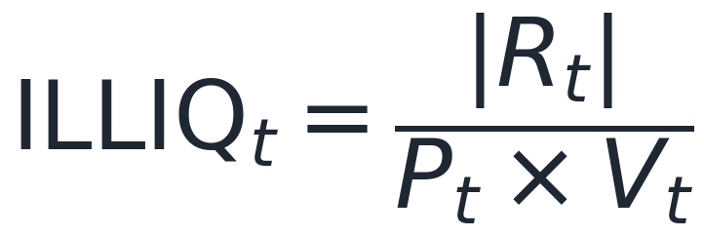
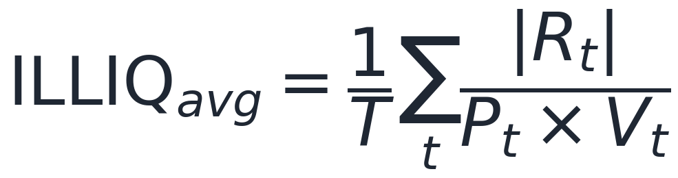
Amihud Illiquidity Ratio
Interpretation
R_{t} is the daily log return on day t
P_{t} is the closing price on day t
V_{t} is the daily trading volume (shares) on day t
P_{t} times V_{t} is dollar trading volume
ILLIQ measures price impact per dollar: higher means less liquid
Amihud (2002): ILLIQ predicts equity risk premia cross-sectionally
Scale by one billion for readability (values are tiny for liquid assets)
Notes:
Numerator is absolute return (price impact), denominator is dollar volume (the liquidity supply). Ratio captures how much price moves per dollar traded. For a liquid stock like SPY the ratio is tiny; for a small-cap it can be 100 to 1000 times larger. The time-series average is used as a stock-level liquidity measure in cross-sectional return regressions.

Slide 16
Worked Example: Amihud Illiquidity Ratio
Three days of data for a small-cap stock
Day 1: |return| 1.2%, dollar volume $6.0M (300k shares x $20)
Day 2: |return| 0.8%, dollar volume $10.0M (500k shares x $20)
Day 3: |return| 2.0%, dollar volume $4.75M (250k shares x $19)
Daily ILLIQ = |return| / dollar volume
Day 1: 0.012 / 6.0M = 2.0 x 10^-9
Day 2: 0.008 / 10.0M = 0.8 x 10^-9
Day 3: 0.020 / 4.75M = 4.2 x 10^-9
Average and interpretation
Mean ILLIQ = (2.0 + 0.8 + 4.2) / 3 = 2.3 x 10^-9 (about 2.3 per $1bn traded)
Day 3 is least liquid: a small dollar volume moved the price the most; a mega-cap scores near zero
Notes:
Three hand-calculable days. ILLIQ is |return| divided by dollar volume, so a big price move on light volume (Day 3) scores high = illiquid. The average, scaled by a billion, is 'price impact per $1bn traded'. Liquid mega-caps score near zero on the same scale.

Slide 17
Liquidity Funding Risk
Sources of liquidity
  Cash and Treasury securities
  Ability to liquidate trading positions
  Ability to borrow
  Retail and wholesale deposits
  Securitization
  Central bank borrowing

Slide 18
Regulation
Liquidity coverage ratio: designed to make sure that the bank can survive a 30-day period of acute stress
Net stable funding ratio: a longer-term measure designed to ensure that stability of funding sources is consistent with the permanence of the assets that have to be funded

Slide 19
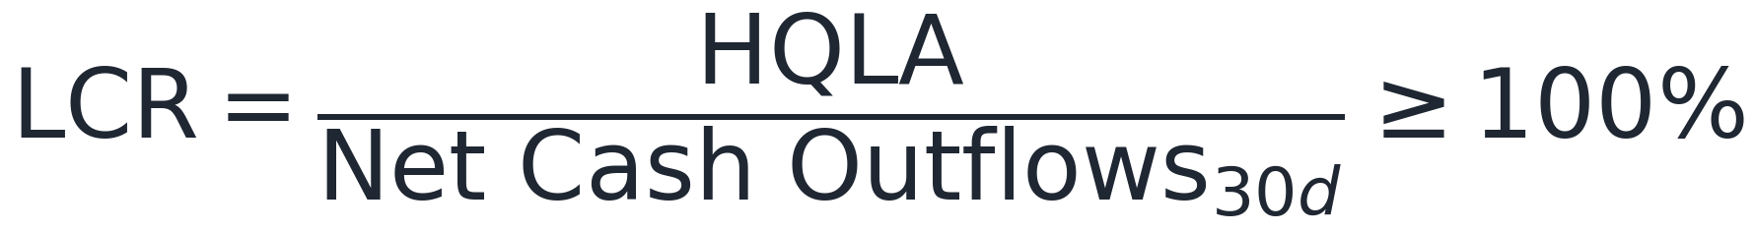
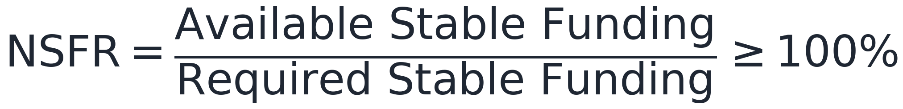
Regulatory Liquidity Standards - LCR and NSFR
Liquidity Coverage Ratio (LCR)
HQLA is High Quality Liquid Assets (cash, Treasuries)
Stress scenario: 30-day outflow assumptions by category
Ensures banks survive a 30-day acute stress episode
Introduced: Basel III (2013); fully phased in 2019
Net Stable Funding Ratio (NSFR)
Longer-term (1-year) structural funding metric
ASF: equity, long-term debt, retail deposits (weighted by stability)
RSF: assets weighted by their liquidity (HQLA gives low RSF)
Basel III final (2017); complements LCR at longer horizon
Notes:
The GFC exposed that banks were highly profitable in normal times but had no liquidity buffer when short-term funding markets froze. LCR solves the 30-day problem; NSFR solves the structural mismatch problem. Both are at least 100%, which is the key number. SVB (2023) technically passed LCR but failed when long-maturity bond portfolio losses triggered a funding run, a reminder that regulation lags innovation in risk-taking.

Slide 20
Worked Example: LCR and NSFR
LCR: survive a 30-day stress
HQLA buffer = $80M (cash + Treasuries)
Stressed 30-day outflows: retail $200M x 5% = $10M; wholesale $100M x 40% = $40M
Inflows (capped at 75% of outflows) = $12M
Net outflows = (10 + 40) - 12 = $38M -> LCR = 80 / 38 = 211% (>= 100%, passes)
NSFR: a 1-year structural view
Available Stable Funding (equity + long debt + stable deposits) = $90M
Required Stable Funding (illiquid assets, tenor-weighted) = $85M
NSFR = 90 / 85 = 106% (>= 100%, passes)
Takeaway
LCR asks 'can we survive 30 days of run-off'; NSFR asks 'are long assets funded by stable money'
Notes:
Both Basel ratios computed by hand. LCR = HQLA / net 30-day stressed outflows (inflows capped at 75%): 80/38 = 211%. NSFR = available stable funding / required stable funding over a year: 90/85 = 106%. Both clear the 100% floor.

Slide 21
Case Study: Northern Rock (2007)
What happened (the UK's first bank run in 140 years)
Northern Rock: UK mortgage lender; relied heavily on wholesale funding
Business model: securitise mortgages, fund with short-term repo and debt (commercial paper)
Aug 2007: US subprime losses freeze securitisation markets
  Northern Rock could not roll over its short-term wholesale funding
Sep 13, 2007: Bank of England emergency loan announced, public panic followed
  Retail depositors queued outside branches; 1B GBP withdrawn in days
Loss: about 110B GBP in liabilities; nationalised Feb 2008; cost about 37B GBP to taxpayers
Key lessons
Maturity mismatch: funding short-term, lending long-term is fragile
Funding liquidity can collapse overnight when confidence breaks
Retail deposit insurance (FSCS) was insufficient to stop the run
Digital bank runs (SVB 2023) happen even faster via smartphones
Notes:
Northern Rock is the canonical UK funding-liquidity failure. It predates the Lehman collapse by a year and shows that a bank with mostly prime-quality assets can still fail if its funding model is fragile. The lesson for LCR: if Northern Rock had needed to hold 30 days of HQLA against its runnable liabilities, the crisis might have been contained. Connect to NSFR: the maturity-transformation model was the structural flaw.

Slide 22
Liquidity Black Holes and Feedback Trading
How Liquidity Vanishes
Positive-feedback trading: selling begets more selling (stops, margin calls, VaR limits)
A liquidity black hole: everyone on the same side, no natural buyers left
Leverage cycle: falling prices, higher haircuts, forced deleveraging, lower prices
Triggers and Amplifiers
Mechanical rules: stop-losses, VaR/risk limits, dynamic hedging, index and ETF rebalancing
Crowded trades plus high leverage equals fragility
Brunnermeier (2009): funding and market liquidity spirals reinforce each other
Notes:
This is the dynamic, systemic face of liquidity risk, the bridge to Session 12. Negative-feedback (contrarian) trading stabilises markets; positive-feedback (trend-chasing, forced) trading destabilises them and creates liquidity black holes. Stress how ostensibly prudent rules (stop-losses, VaR limits, margin, dynamic hedging) are individually rational but collectively procyclical. Brunnermeier (2009) is the supplementary reading; tie the leverage cycle back to LTCM from Session 1.

Slide 23
The Leveraging Cycle
Investors allowed to increase to leverage
They buy more assets
Asset prices increase
Leverage of investors decreases

Slide 24
The Deleveraging Cycle
Investors required to reduce leverage
They do this is by selling assets
Asset prices decline
Leverage of investors increases

Slide 25
Is Liquidity Improving?
Spreads are narrowing
But arguably the risks of liquidity black holes are now greater than they used to be
It is important to have diversity in financial markets where different groups of investors are acting independently of each other

Slide 26
Block 2: Operational Risk
Definition, Basel framework, loss model, and case studies
Loss events are rare but catastrophic - a distinct data challenge
The compound Poisson-lognormal model captures both frequency and severity
Notes:
Block 2 covers Hull Ch. 20 and Jorion Ch. 25. Operational risk is the other Basel pillar: it has capital charges, complex models, and a distinct data challenge: loss events are rare but catastrophic. The Poisson-lognormal model captures both features.

Slide 27
What Is Operational Risk?
Basel II definition: “loss from failed internal processes, people, systems, or external events”
Four root causes: processes, people, systems, external events
7 Basel loss-event types:
  Internal fraud (e.g., Kerviel at Societe Generale, 2008)
  External fraud (e.g., cyber attacks, phishing, card skimming)
  Employment practices and workplace safety
  Clients, products and business practices (mis-selling, suitability)
  Damage to physical assets (9/11, natural disasters)
  Business disruption and system failures (IT outages, cloud failures)
  Execution, delivery and process management (settlement fails, model errors)
Residual and unexpected losses: cyber, pandemic, climate (emerging)
Distinct from market and credit risk: non-financial origin, hard to model
Notes:
Emphasise the four-word Basel definition (processes, people, systems, external events). Ask students to classify a recent news story: data breach equals cyber equals external fraud; rogue trader equals internal fraud. The seven categories are testable and appear in Hull and Jorion. Cyber risk is the fastest-growing sub-category; BCBS 2003 predates it but the framework still applies.

Slide 28
The Biggest Risk?
Operational risk is difficult to quantify but is now regarded as the biggest risk facing banks
Cyber risk is a huge issue flor financial institutions
Compliance risks can lead to huge losses (e.g. BNP Paribas’s $9 billion loss in 2014)

Slide 29
Loss Severity vs Loss Frequency
Loss frequency should be estimated from the banks own data as far as possible. One possibility is to assume a Poisson distribution so that we need only estimate an average loss frequency. Probability of n events in time T is then
Loss severity can be based on internal and external historical data. One possibility is to assume a lognormal distribution so that we need only estimate the mean and SD of losses.

Slide 30
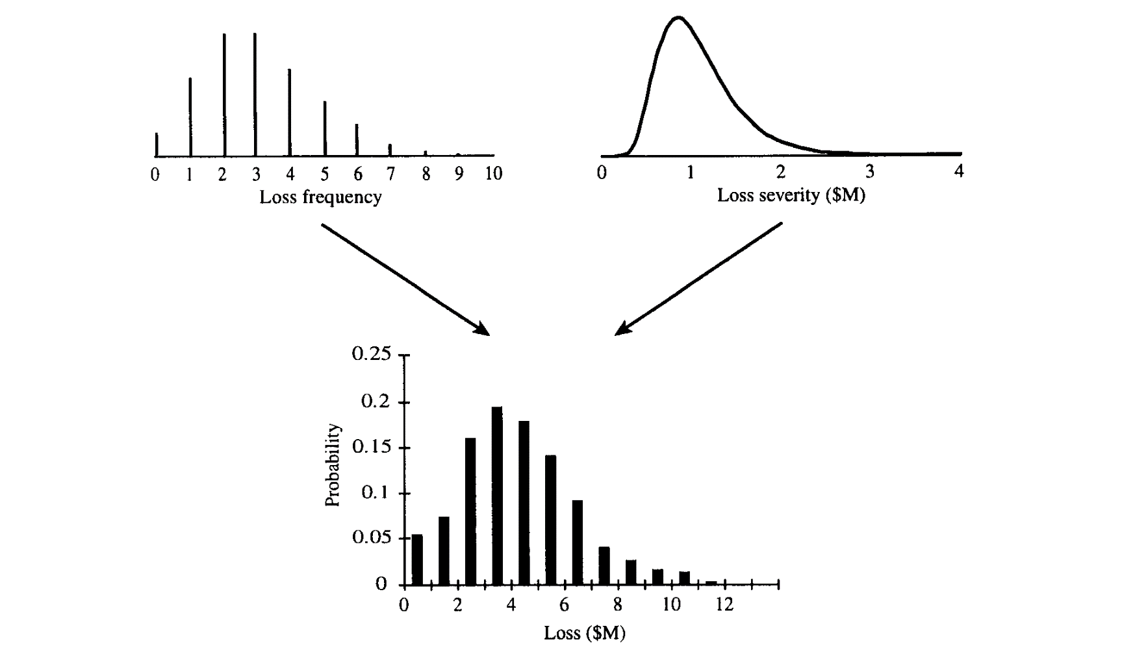
Using Monte-Carlo to combine the Distributions

Slide 31
Worked Example: One Simulated Year of Op Losses
Model: frequency Poisson(lambda = 3), severity Lognormal(mu = 14, sigma = 1.2)
Single-loss median = e^14 = $1.20M; mean = e^(14 + 0.5 x 1.2^2) = $2.47M
Simulate one year
Draw N from Poisson(3) -> suppose N = 4 events this year
Draw 4 severities: $0.8M, $1.5M, $0.6M, $9.0M
Aggregate annual loss S = 0.8 + 1.5 + 0.6 + 9.0 = $11.9M
One draw is not the answer
Repeat 100,000 times to build the distribution of S
Expected S = lambda x mean severity = 3 x 2.47M = $7.4M
Takeaway
The $9.0M tail event dominated this year; capital is about rare tail years, not the average
Notes:
The compound Poisson-lognormal in one draw. Frequency Poisson(3) gives N=4 events; four lognormal severities sum to $11.9M for the year. Expected annual loss is lambda x mean severity = $7.4M, but the single $9.0M tail event dominated, which is why capital targets the rare bad years.

Slide 32
Worked Example: OpVaR from Simulated Years
Ten simulated annual losses ($M), sorted
2, 3, 4, 5, 6, 7, 9, 12, 18, 40
Read the distribution
Expected loss (mean) = 106 / 10 = $10.6M
90% VaR = the 90th percentile = about $18M
Expected Shortfall(90%) = average of losses beyond $18M = $40M (one exceedance here)
Why real runs use 100,000-plus simulated observations
The 99.9% point is 1 year in 1,000; you cannot see it in 10 or even 1,000 draws
A single extra tail draw can move the estimate sharply
Takeaway
The tail quantile is where the capital sits, and it is the hardest part to estimate
Notes:
Ten simulated years make the percentile mechanics visible: mean $10.6M, 90% VaR ~$18M, ES(90%) $40M. The 99.9% capital point is 1 year in 1,000, invisible in a small sample, which is why real op-risk runs use 100,000+ simulated years and still carry wide error.

Slide 33
Operational Risk - Case Studies
Barings Bank (1995) - Rogue Trading
Nick Leeson: unauthorised derivatives trades in Singapore
Loss: about 830M GBP (about 1.3B USD), wiped out the entire bank
Category: Internal Fraud / Execution and Process Management
Control failure: Leeson ran both trading desk and back office
Lesson: segregation of duties is not optional
Societe Generale / Kerviel (2008) - Rogue Trading
Jerome Kerviel: 49.9B EUR notional in hidden equity futures
Loss: 4.9B EUR when positions unwound, market impact included
Category: Internal Fraud
Control failure: risk limits exceeded; alerts suppressed
Lesson: large position limits require real-time monitoring
Notes:
Walk each case briskly and classify by Basel loss-event type. Try to identify the control failure. The London Whale is a perfect exam question: it crossed model risk, operational risk, and market risk. SVB is the most recent and shows that digital bank runs (Twitter plus mobile app) are orders of magnitude faster than Northern Rock. Cummins, Lewis and Wei (2006) showed markets price these losses; ask students how they would trade on an op-risk announcement.

Slide 34
Operational Risk - Case Studies II
JPM London Whale (2012) - Model Risk
Bruno Iksil: complex credit derivatives (CDS indices)
Loss: about 6.2B USD; initially modelled as near-zero VaR
Category: Clients, Products and Business Practices
Control failure: VaR model changed mid-crisis; Excel error
Lesson: model risk equals operational risk; independent validation
SVB (2023) - Funding Liquidity / Op Risk
Silicon Valley Bank: concentrated held-to-maturity bond portfolio
Rising rates gave unrealised losses of about 17B USD (not in VaR)
Loss: 20B USD-plus writedown; 42B USD run in a single day via app
Category: Execution and Process Management; Business Disruption
Lesson: AOCI exclusion from capital was a regulatory gap

